Slide 1
Sandra Moon complex

Slide 2
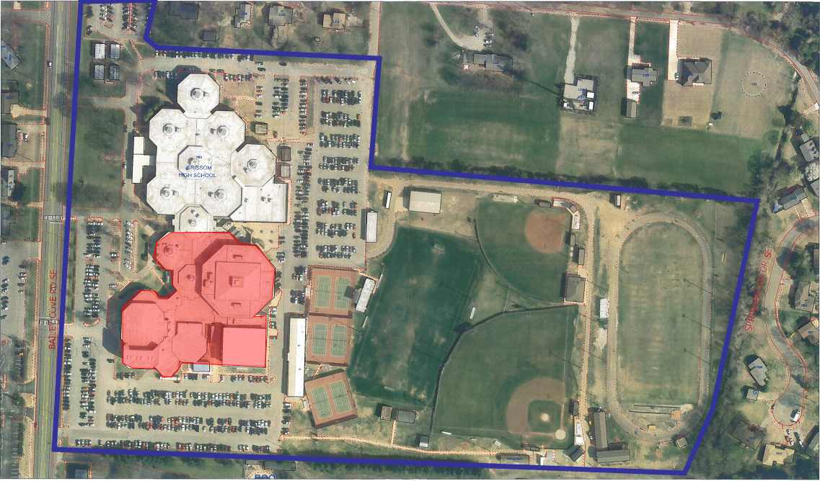

Slide 3
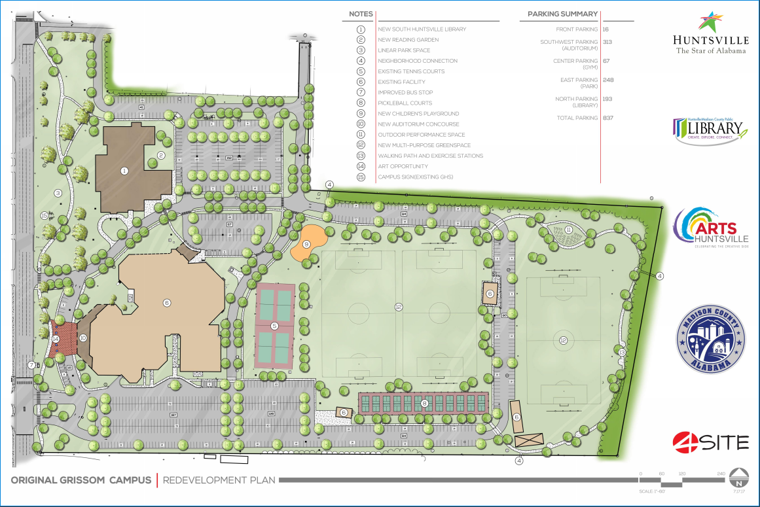

Slide 4
