Slide 1
Huntsville Housing Authority’s mission is to develop and preserve a high standard of safe, affordable housing for qualifying individuals and families, free from discrimination. HHA believes housing is a basic need and the foundation for a successful life. HHA’s dedicated staff, along with community partners, will promote neighborhood revitalization, self-sufficiency, and assist our families in achieving long-term economic success and a sustained high quality of life.

Slide 2
History
The Authority was started because there was a need for a defense housing project to house workers at Redstone Arsenal and the Chemical Warfare Plant that was under construction. It was felt that housing was needed for people who worked in industries in Huntsville engaged in the production of essential elements to the National Defense and war efforts. After many meetings between the Army and the Housing Authority, Huntsville was not awarded the contract to provide the housing, but later they were granted funds to provide housing for low-income individuals.
The first organizational meeting was held on August 20, 1941, at 7:30 p.m. at City Hall.
Present at that meeting were
Herbert Johnson
H. E. Monroe
W. L. Hunter
Ashford Todd
William Oscar Mason

Slide 3
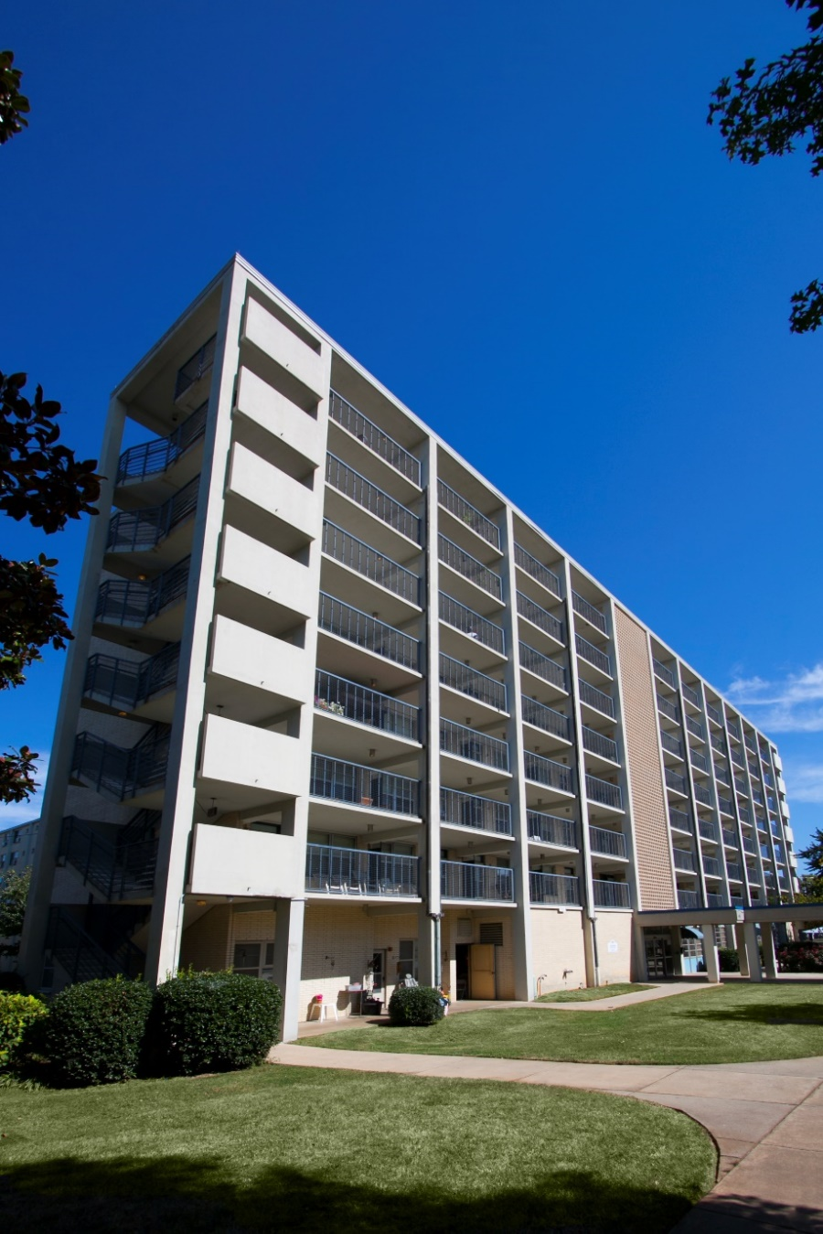
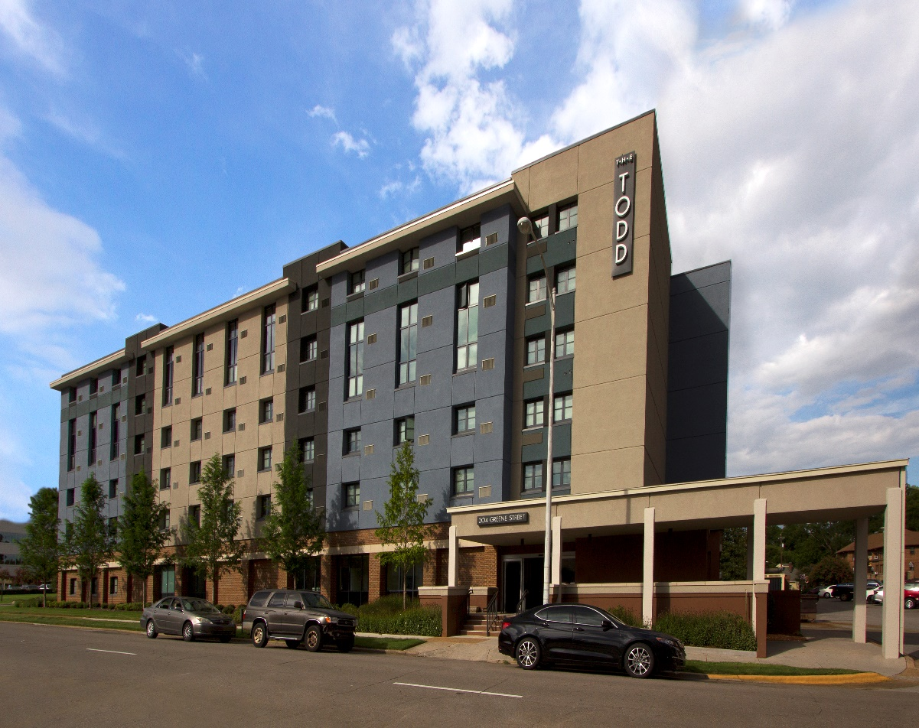
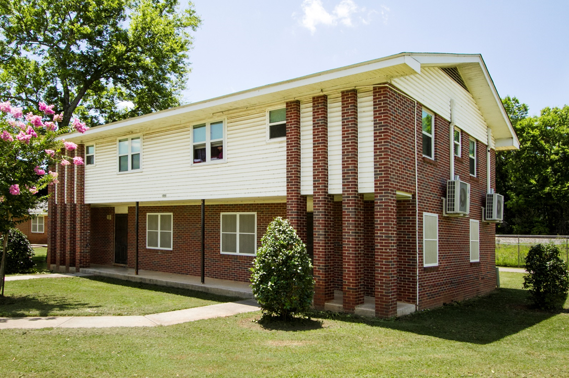
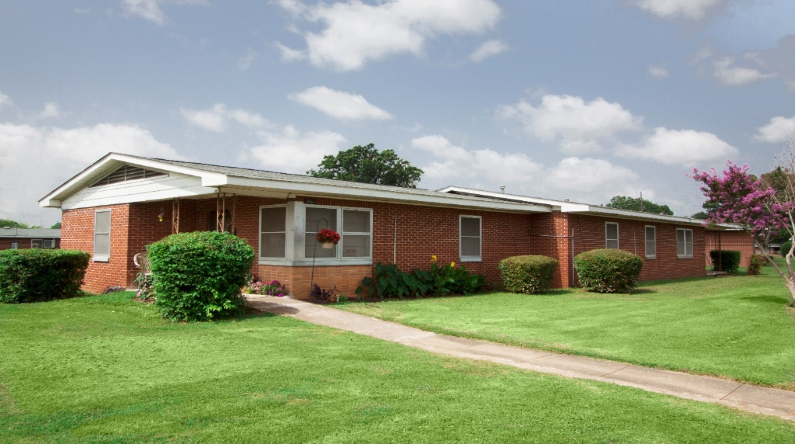
What is public housing?
Public housing was established to provide decent and safe rental housing for eligible low-income families, the elderly, and persons with disabilities. Public housing comes in all sizes and types, from scattered single-family houses to high rise apartments for elderly families. The U.S. Department of Housing and Urban Development (HUD) administers Federal aid to local housing agencies (HAs) that manage the housing for low-income residents at rents they can afford.

Slide 4
Brookside
Butler Terrace
Johnson Towers
L R Patton
Lincoln Park
Northwoods
Searcy Homes
Stone Manor
Scattered Sites
The Todd
HHA Public Housing Communities
HHA has apartments and homes located throughout the city of Huntsville that are dedicated to extremely low, and low-income residents. The housing units range in size from efficiencies to five-bedroom apartments, and single family homes, and have rent amounts that are well below market rates. Public housing in Huntsville is directly subsidized by the U.S. Department of Housing and Urban Development (HUD) and managed by HHA. Rent amounts in public housing are set at 30% of the adjusted gross household’s monthly income.

Slide 5
What is fair market rent?
Fair Market Rents (FMRs) are published annually by HUD and are used in the calculation of flat rents for the HCV (Section 8) and Public Housing programs.
For Public Housing, this is the maximum rent that a tenant will pay even if the rent calculation based on their income would be more than this amount.
Fair Market Rent prices in Huntsville are high compared to the national average. This FMR area is more expensive than 76% of other FMR areas.
In 2022, Fair Market Rent for a two-bedroom apartment in Huntsville is $897 per month.
The previous year, rent for a two-bedroom home was $821 per month. This is a 8.69% increase.
Compared to the rest of Alabama, the Huntsville FMR area is more expensive than 91% of the state.
HUD.gov/RentData.org (2021)

Slide 6
Rental Market Trends
The average rent for an apartment in Huntsville is $1,105. The cost of rent varies depending on several factors, including location, size, and quality.
Huntsville apartment rent ranges
$501-$700: 14%
$701-$1,000: 29%
$1,001-$1,500: 44%
$1,501-$2,000: 12%
> $2,000: 1%
Rent Café 2022

Slide 7
12% earn less than $4,999
15% earn between $5,000 and $9,999
35% earn between $10,000 and $14,999
12% earn between $15,000 and $19,999
9% earn between $20,000 and $24,999
5% earn between $25,000 and $29,999
11% earn over $30,000
Gross Annual Income for HHA Families
Public Housing Income Data

Slide 8
Rent Negotiations with Landlords
What is affordable for one family may not be affordable for another.
A family’s budget affected not just by the amount of income, but also certain expense and family composition.
Landlords may be asked to adjust the contract rent, even though it’s reasonable, because a family’s circumstances make the “asking rent” for a unit unaffordable.
Landlords are not required to reduce the rent, if asked.
If a tenant cannot afford a unit, and the landlord does not agree to reduce the rent, the family must continue looking for an affordable unit.
It is the landlord’s choice to participate or not, but if you agree to work with the program, then you must follow the rules.

Slide 10
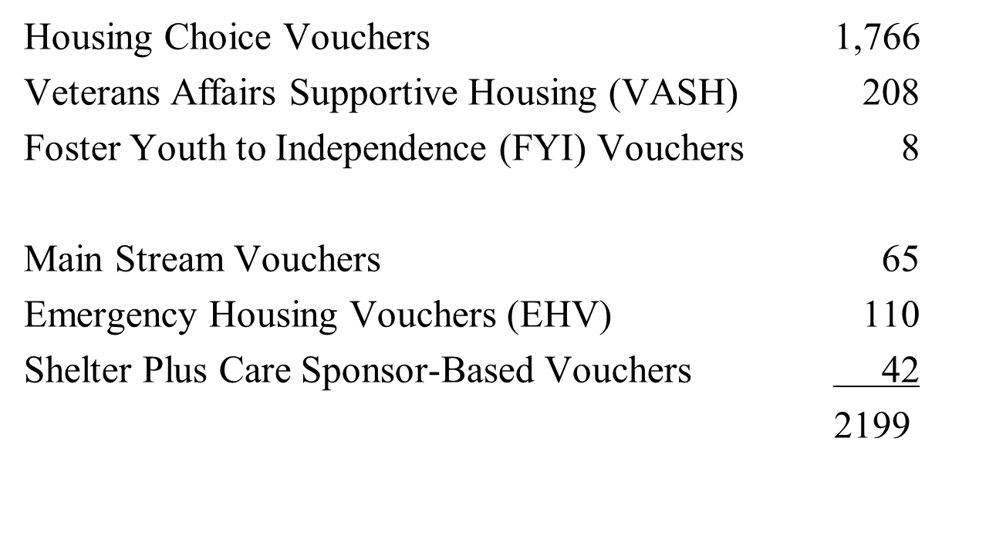
Housing Choice Voucher (Section 8) Allocations

Slide 11
Foster Youth to Independence
HUD’s Foster Youth to Independence (FYI) Initiative is a program that provides housing assistance for up to 36 months to youth under the age of 25 with a child welfare history who are at-risk-of or experiencing homelessness. HHA was awarded 8 FYI vouchers.

Slide 12
Emergency Housing Vouchers
Huntsville Housing Authority was selected to receive 110 EHVs and funding as authorized by the American Rescue Plan Act of 2021. These EHVs are to assist individuals and families who are experiencing homelessness; at risk of experiencing homelessness; fleeing, or human trafficking; or were recently homeless and for whom providing rental assistance will prevent he family’s homelessness or having high risk of housing instability.

Slide 13
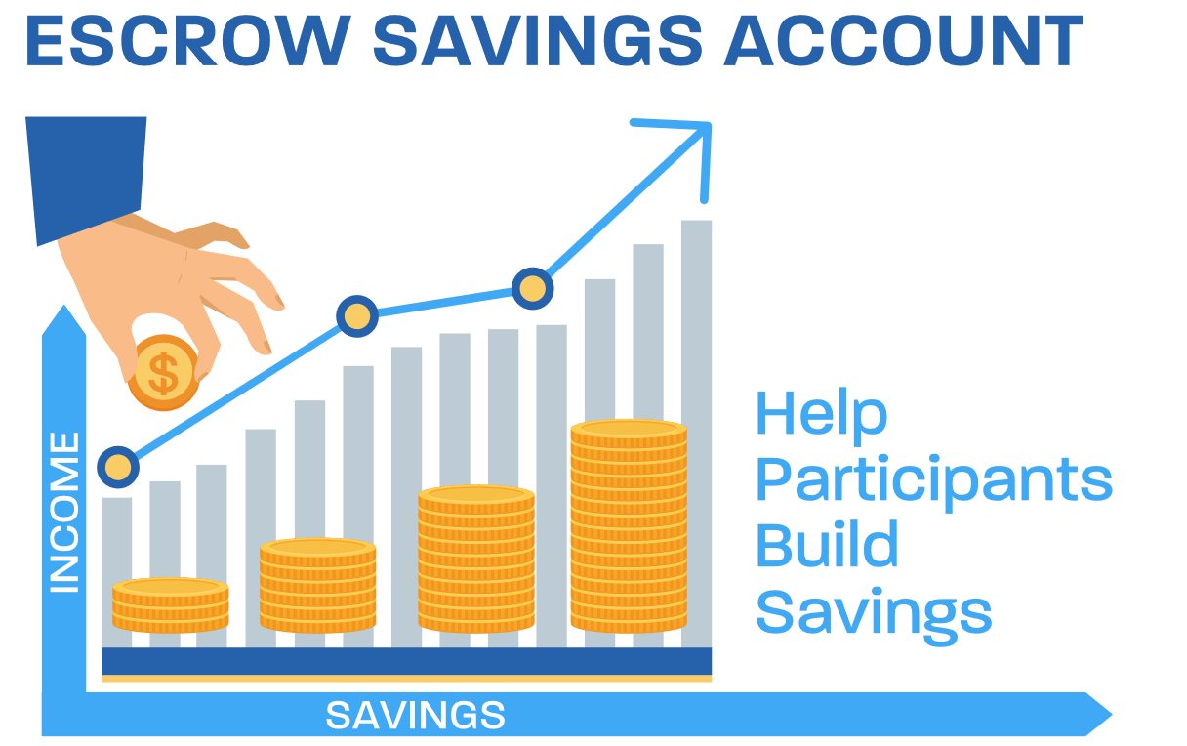
FSS is a program that allows participants to build financial assets as the household earned income from wages increases. Once an eligible family is selected to participate in the program, the PHA, and the head of each participating family execute a FSS Contract of Participation that specifies the rights and responsibilities of both parties. Participants identify educational, professional and personal goals. The term of the FSS contract is generally 5 years, but it may be extended for another 2 years by the PHA for good cause.

Slide 14
It’s like a new life for us.
Youth & Family Program
Youth Activities
Family Support
Community Involvement
Resident Services
We understand that people often need more than a decent, safe, and affordable place to live, they need to be able to build a stable life. In addition to housing options we provide Resident Services.
Elderly & Disabled Program
Health & Wellness
Housing Stability
Homeownership Program
Financial Stability
“Moving Up & Out”

Slide 15
Services Provided:
Blood Pressure Screenings
Exercise Classes
Nutrition Programs
Health and Resource Fairs
Assistance with Completing Needed Forms for HHA and community agencies
Referrals for needed service.
Elderly & Disabled
Coordinated supportive services are provided to assist in enhancing the residents' ability to age in place and improve their quality of life. Services include case management, home delivered meals, transportation, social activities, light exercise, nutrition, safety and financial workshops. Many of the programs are facilitated by local community partnerships.
Community Partners:
The Legacy Center
Alabama Cooperative Extension System, Alabama A&M University
Oakwood University
AETNA
Alabama A&M University Mobile Health Unit
North Alabama Food Bank
District 6

Slide 16
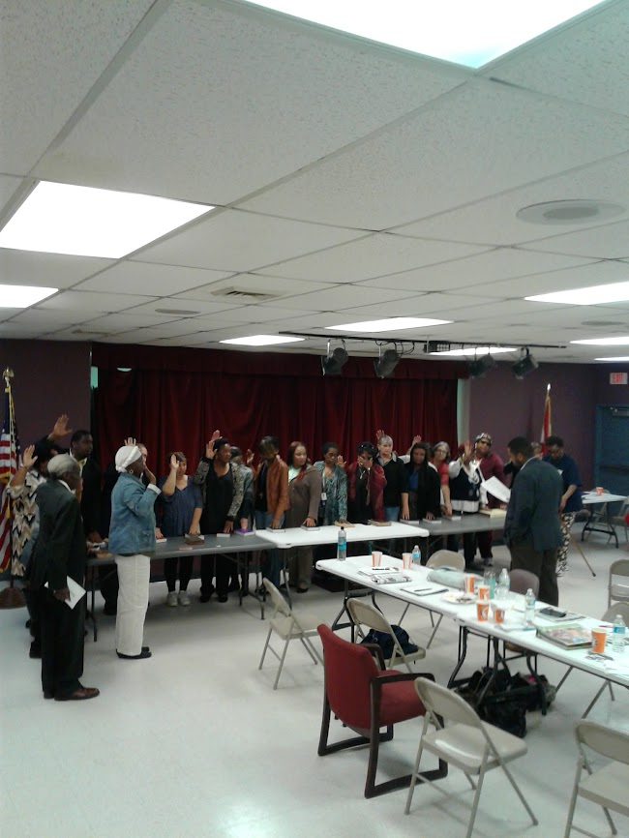
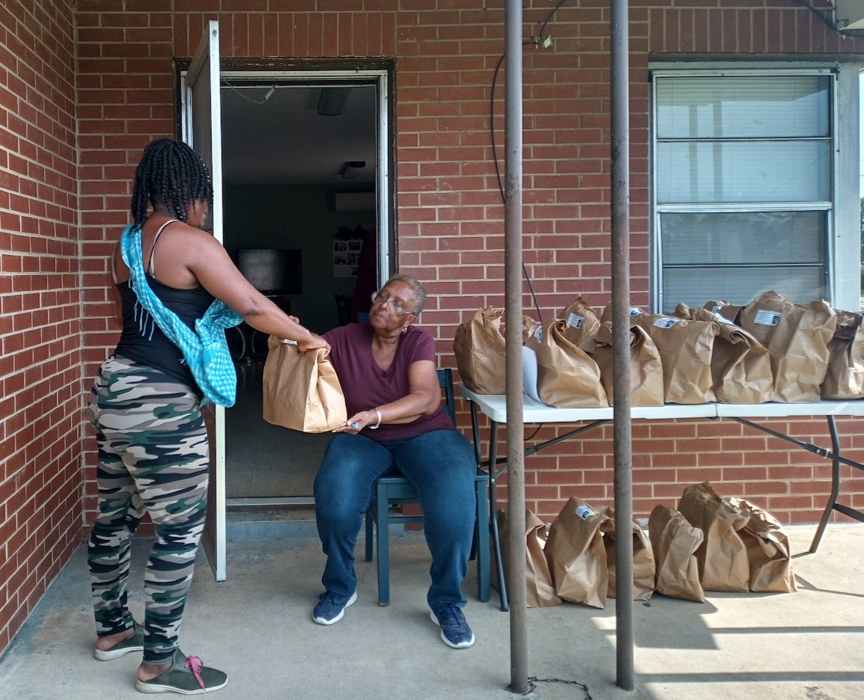
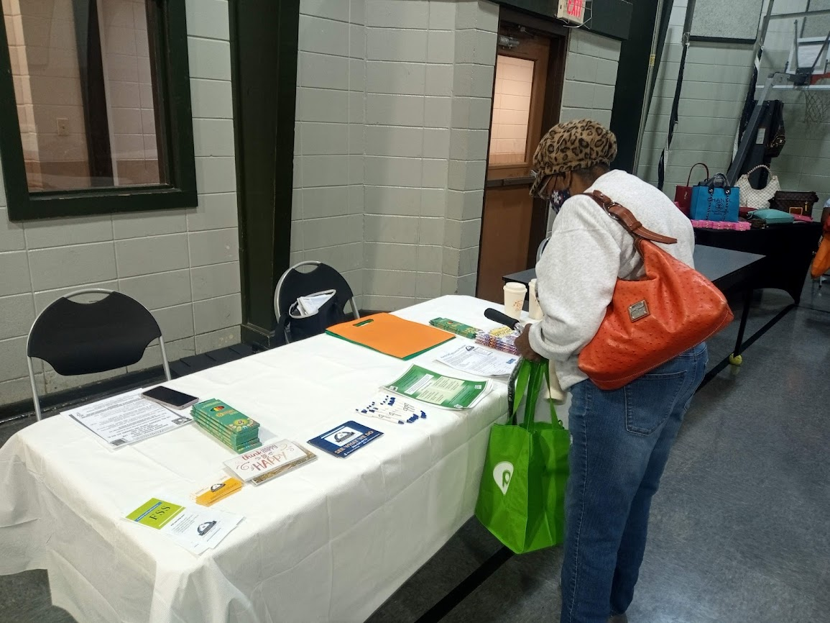
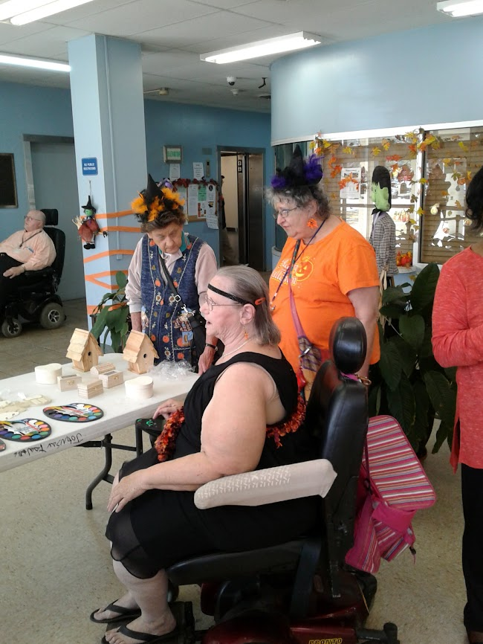
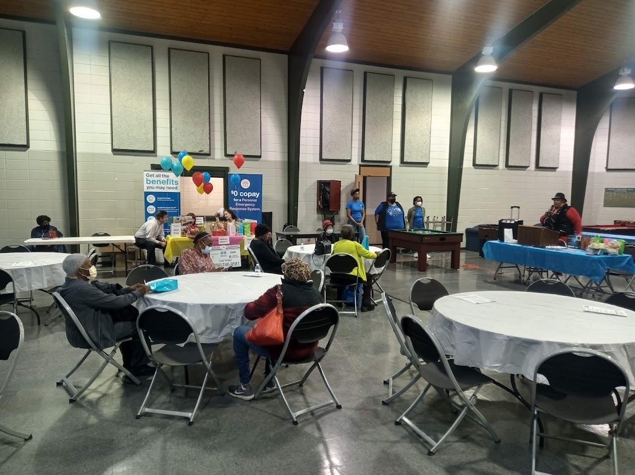
Resident Councils
The role of a Resident Council (RC) is to improve the quality of life and resident satisfaction in self-help initiatives to enable residents to create a positive living environment for individuals and families living public housing. The RCs actively participate and are formally recognized through an executed Memorandum of Understanding with the HHA. The RC membership consists of a democratically governing board elected by the voting membership. RCs serve as the voice of the housing communities that elect them. They have their individual priority programs and goals depending upon the demographics, needs, and aspirations of their communities.

Slide 17
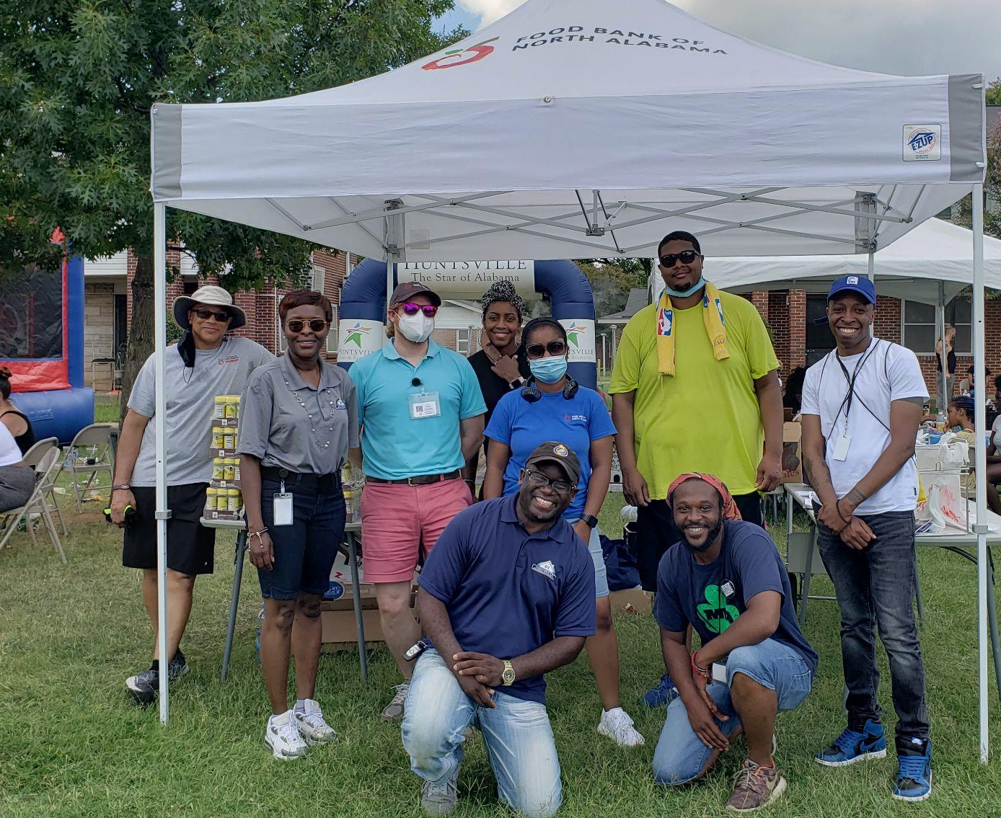
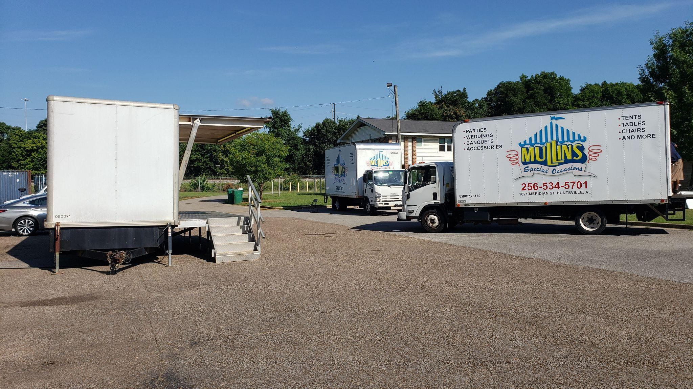
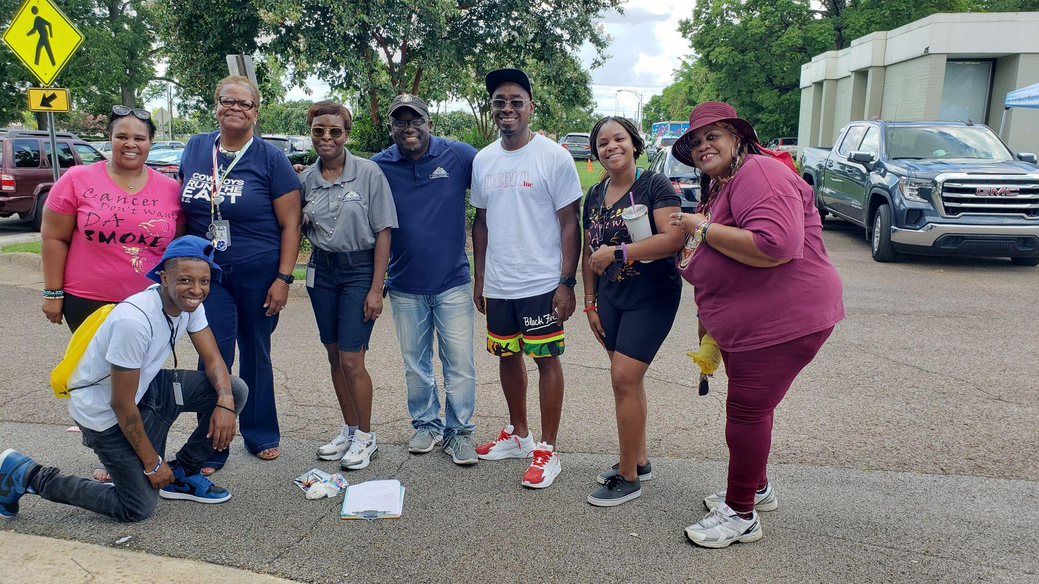
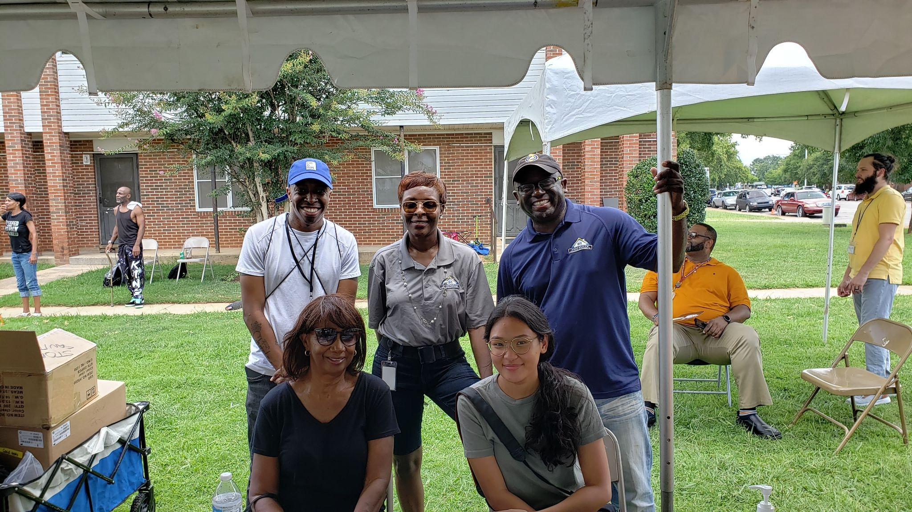
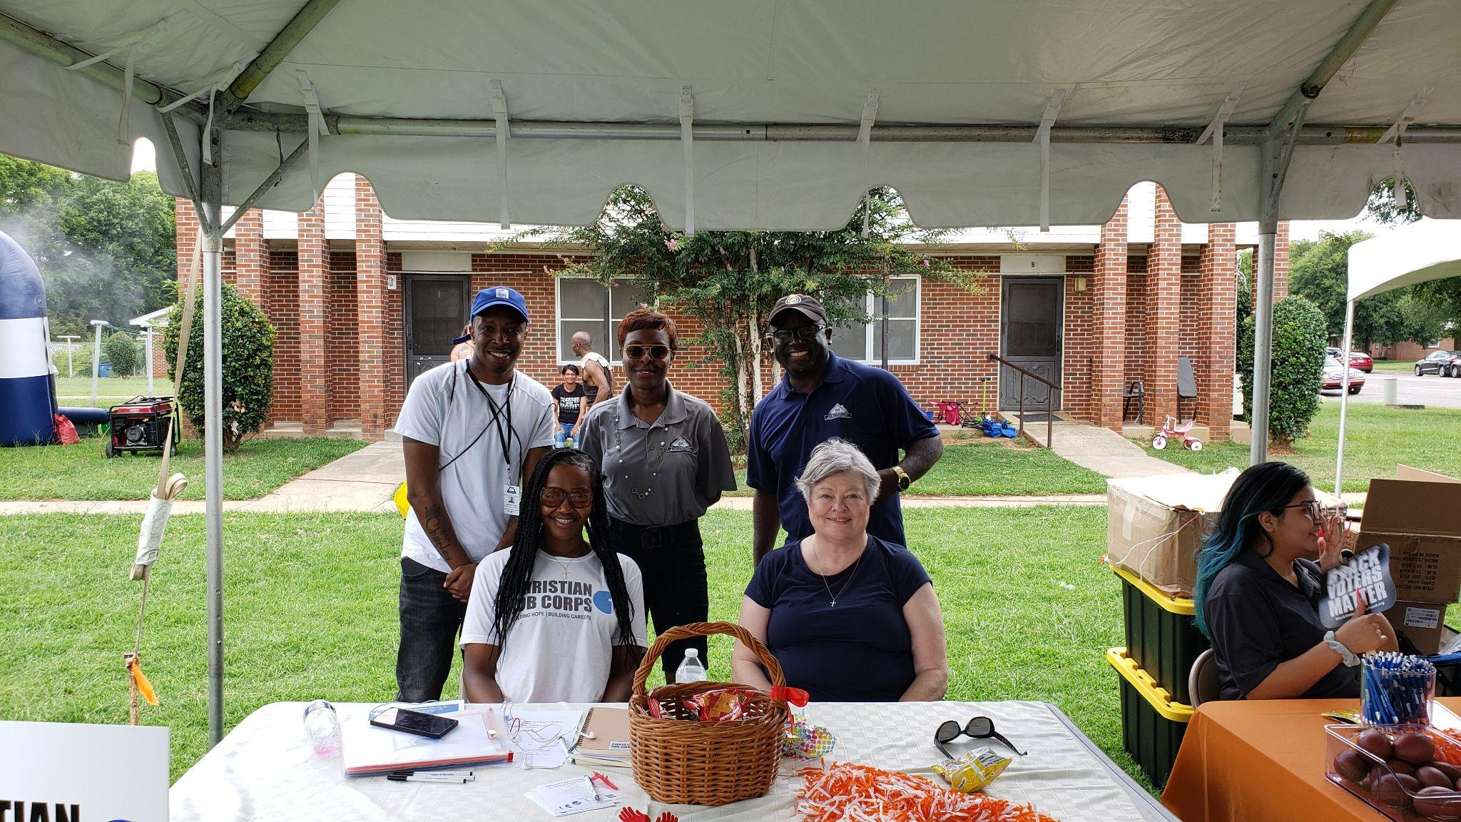
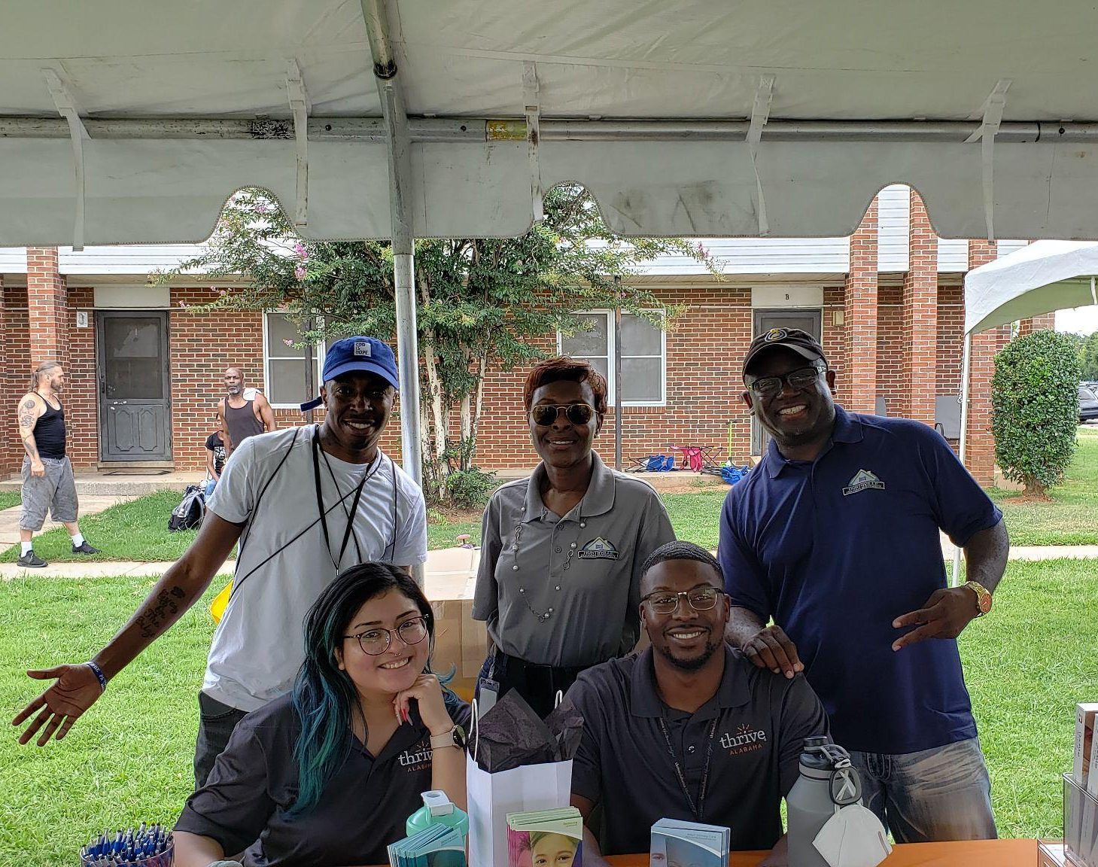
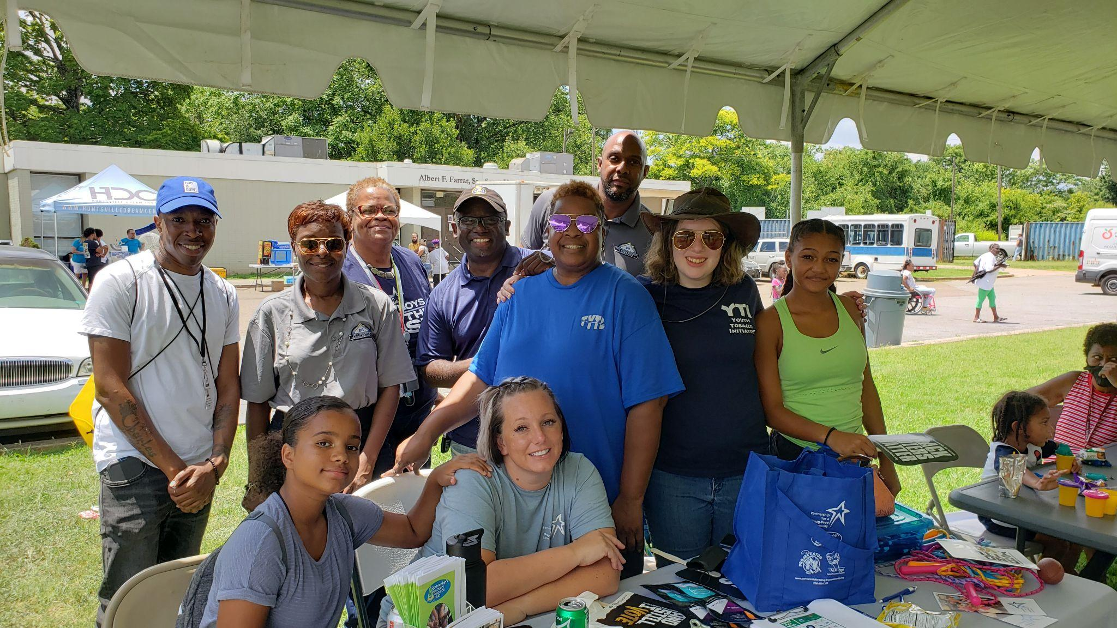
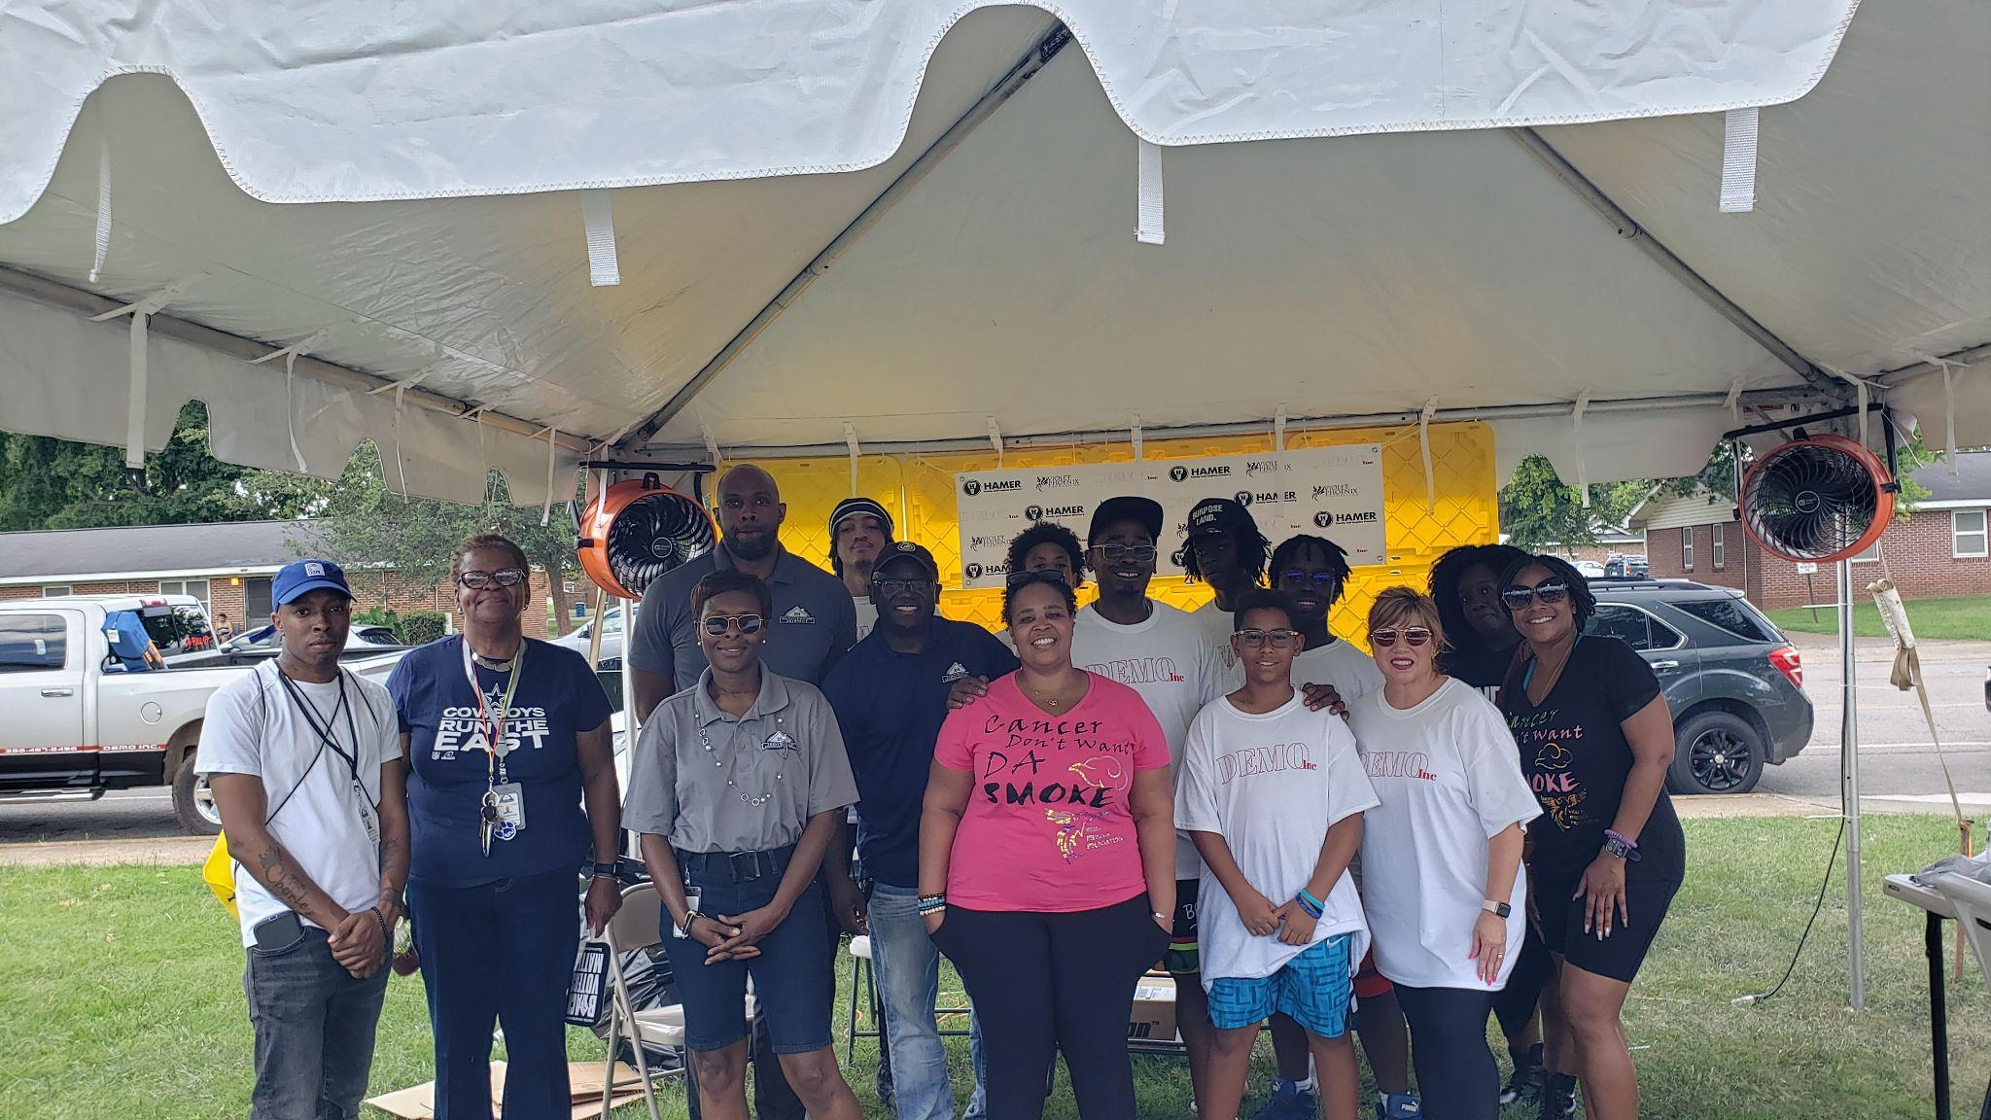
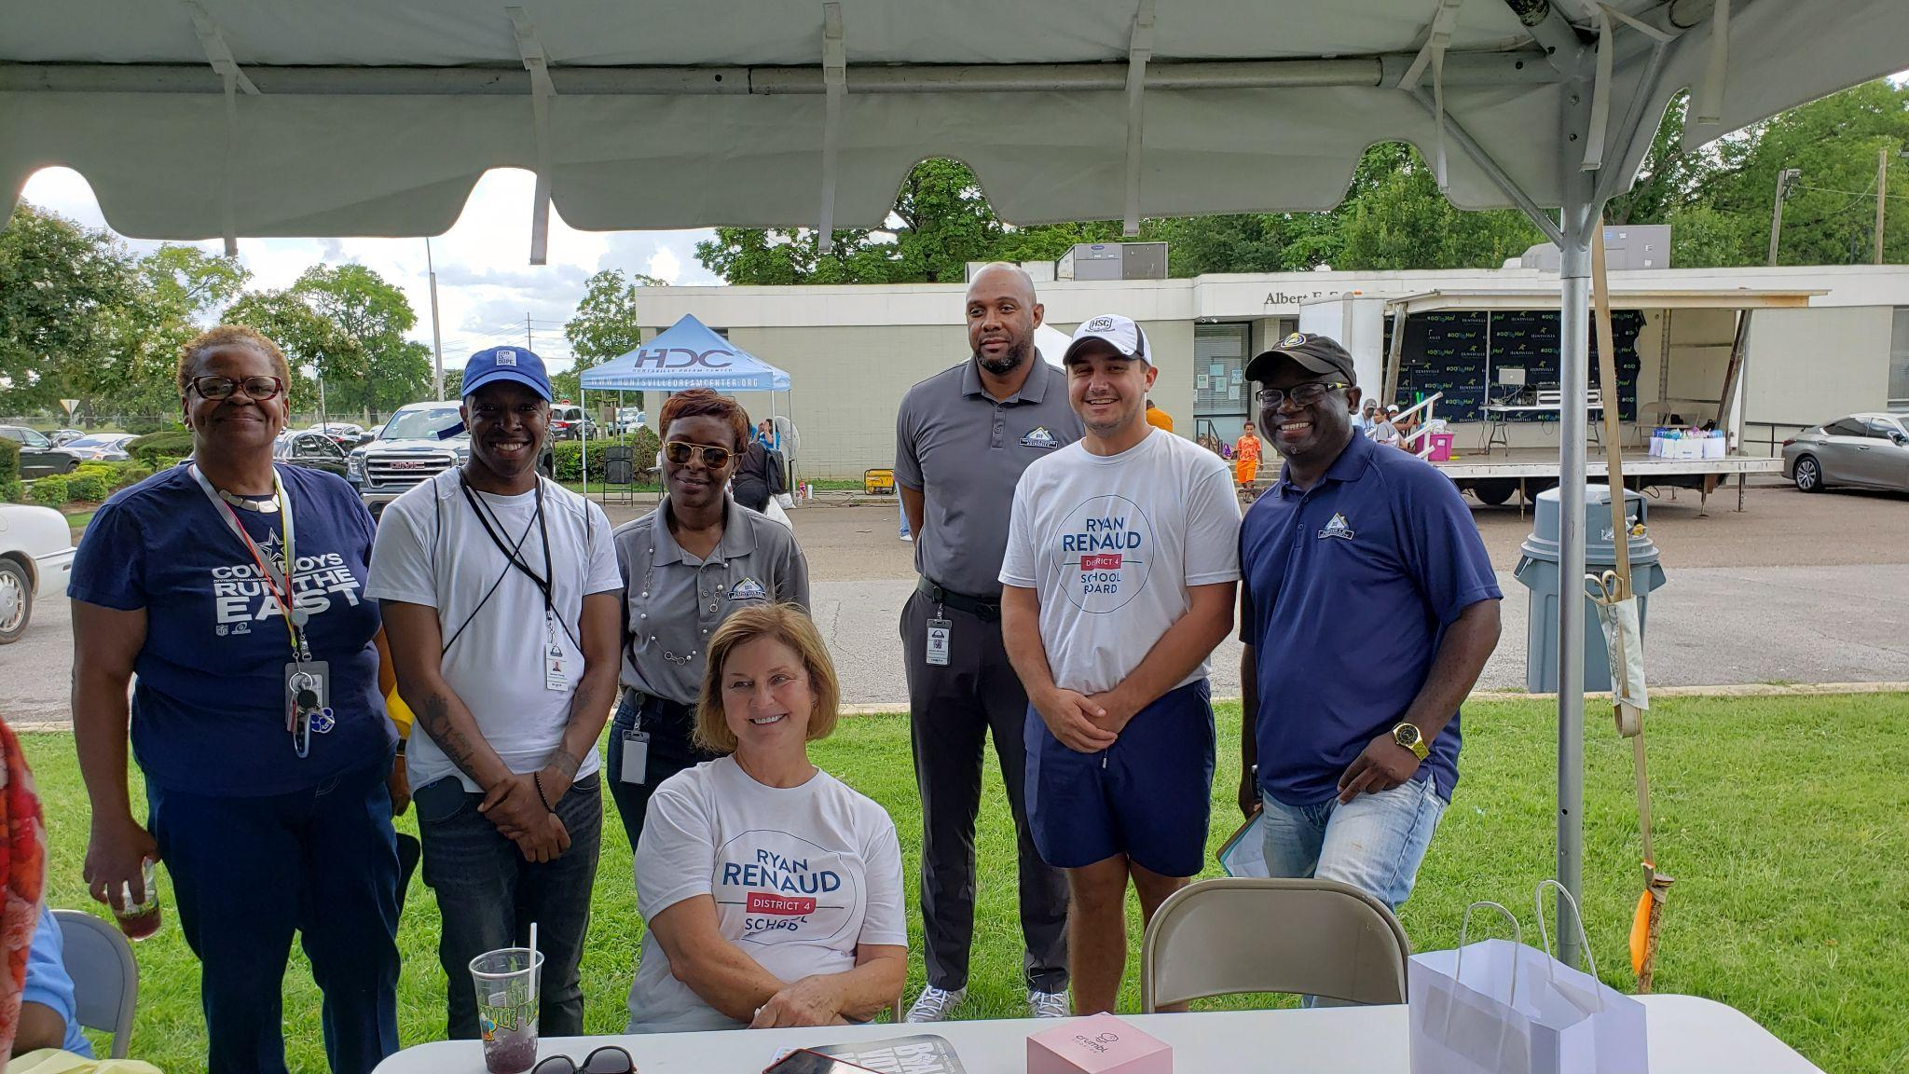
Partnerships & Collaborations
Teamwork Makes The Dreamwork!
Go Team HHA!

Slide 18
Scholarship Opportunities
The Huntsville Housing believes that education, academic achievement and advancement is a key component to self-sufficiency, economic development and achieving one's life’s economic goals and dreams.
We assist our residents in FAFSA assistance, college and career prep, tutoring and academic resources and partner with educational institutions and provide scholarships such as the PHADA, AHAEEF, HAIG, local, state, federal and private scholarship opportunities.
A special congratulations to our Northwoods resident, 2022 Columbia High School graduate, Ms. Salaam Nahasi. She on not only maintaining a 4.0 G.P.A, but graduated with two diplomas, and was nominated for the auspicious “Presidential Award” for the State of Alabama. She is this year’s recipient of the 2022 AHAEEF Scholarship and is attending Berea College in Kentucky with honors. Her concentration is in Cyber Security Computer Science and Business. All the best and know that we all are so proud of you - Keep Rising Queen!
Our Target 02
Our Target 03
Ms. Salaam Nahasi
GPA: 4.0
2022 AHAEEF Scholarship Recipient
$2,500

Slide 19
Homeownership Program
HHA’s Homeownership Program is open to:
Public Housing residents
Housing Choice Voucher participants
The Homeownership Coordinator works with participants one-on-one, community engagement and workshops to remove the barriers to homeownership by preparing clients to become mortgage-ready, enabling them to pre-qualify for loans, and informing them of the range of special financing and mortgage programs available.
Participants learn about the home buying process while receiving one on one housing counseling, education, guidance, and group support.
Affordable home ownership provides stability and increases the well-being of all household members.
Goals:
Improve money management skills.
Develop a household budget and home buying action plan.
Develop a savings plan
Resolve credit issues.

Slide 20
Examine HHA’s Mission
STRATEGIC
PLAN
Align Goals/Objectives
Incorporate Key Stakeholder Input

Slide 21
STRATEGIC PLAN
PRIORITY OUTCOMES
OPERATIONAL
EFFICIENCY, EFFECTIVENESS; HEALTHY, ENGAGED PRODUCTIVE WORFORCE
DRIVE
ENTREPRENEURIAL DIRECTIONS
EXPAND
HOUSING
ACCESS
Section 3/Workforce Development
Establish Non-Profit: Envision Center and Tax Credit Properties
Choice Neighborhood Initiative (CNI)-Butler Terrace
Sparkman Homes
Rental Assistance Demonstration (RAD) Program
Project-Based Voucher (PBV)/Project-Based Rental Assistance (PBRA)
Enhance Landlord Partnerships
Homeownership Program
Fully Utilize Existing Software
Enhance Internal and External Communications
Ensure a Highly Motivated and Trained Staff
Develop Staff Capacity-Recruiting, Hiring, and Training

Slide 22
STRATEGIC PLAN
PRIORITY OUTCOMES
PROMOTE/ACHIEVE STRONGER COMMITMENT TO SELF-SUFFICIENCY
FORGE CREATIVE COLLABORATIONS WITH COMMUNITY PARTNERS
MAINTAIN
HIGH PERFORMER STATUS
Family Self-Sufficiency (FSS)
Resident Opportunity and Supportive Services (ROSS)
Youth and Family Services (YES)
Youth Build
Section 3/Workforce Development
Homeownership Program
Enhance Partnership with City Leadership, Non-profits, and Property Owners
Seek New Funding and Grant Opportunities
Real Estate Assessment Center (REAC) Physical Inspection
Public Housing Assessment System (PHAS)
Capital Fund Score
Section 8 Management Assessment Program (SEMAP)

